Slide 1
The Role of the Pain Expert
Fiona Ashworth

Slide 2
Orthopaedic surgeons

Slide 3
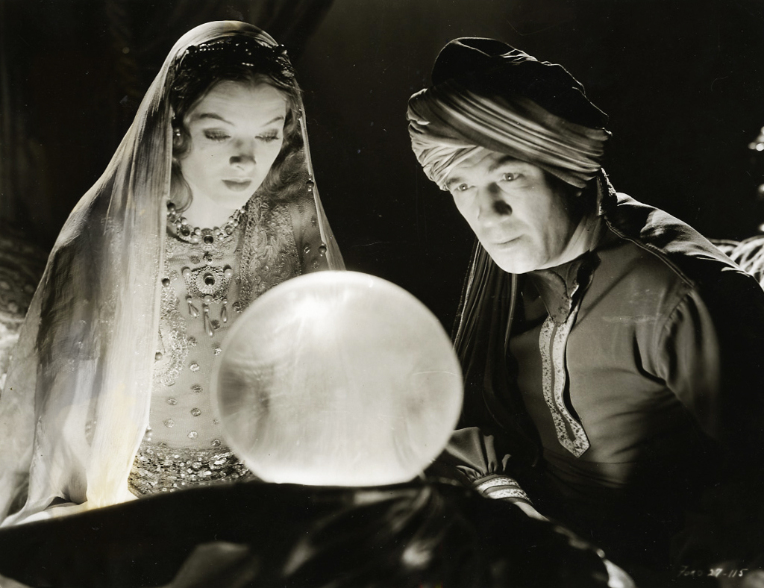

Slide 5
A Certain View

Slide 6
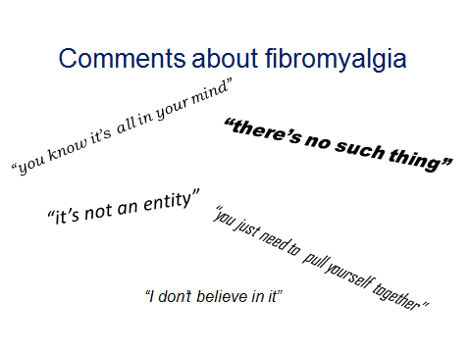
Comments about Fibromyalgia

Slide 7
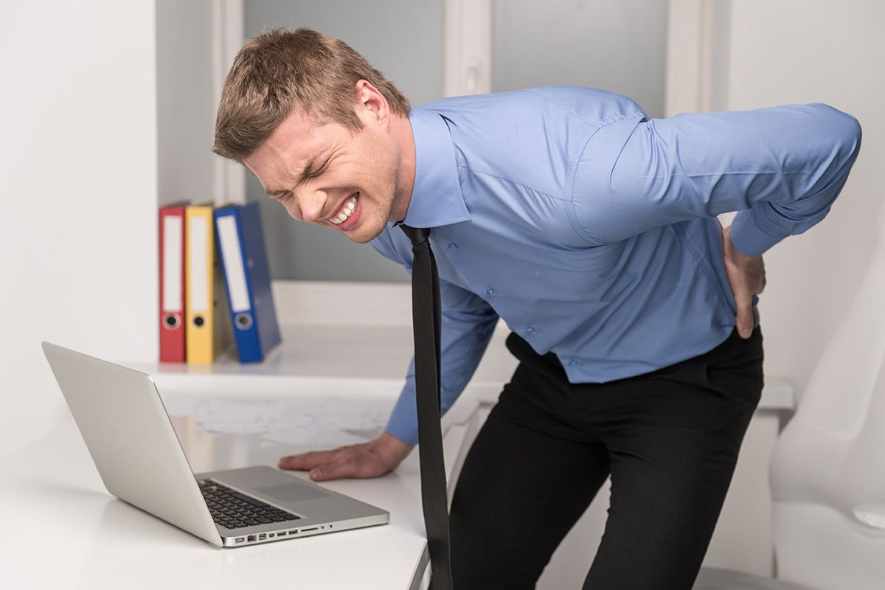
Functional Overlay

Slide 8
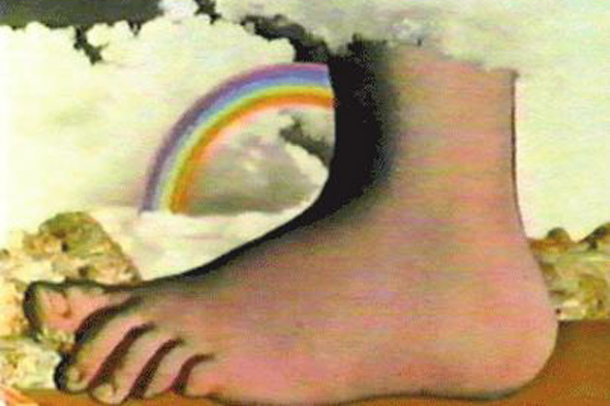

Slide 10
Guidelines
The Judicial College Guidelines for the Assessment of General Damages in Personal Injury Cases now has an entire section on Chronic Pain disorders

Slide 11
Categories and Quantum of PSLA
Complex Regional Pain Syndrome
Severe: £43,890 to £70,240
Moderate: £23,430 to £43,890

Slide 12
Quantum of PSLA
Other pain disorders
Severe: £35,200 to £52,660
Moderate: £17,600 to £32,180

Slide 13
Prevalence Studies
1995 - Woolfe USA - number in study 3,006, chronic widespread pain 11%; fibromyalgia syndrome 2%.
2000 Lindell Sweden - number in study 2,425, chronic widespread pain 4%, fibromyalgia syndrome 4.3%.
2004 Gruppe Germany - number in study 3,969, chronic widespread pain 13%, fibromyalgia syndrome 0.3%.

Slide 14
Statistics
In 2015/16, 770,000 RTA related PI claims were referred to the CRU, of those 680,000 involved soft tissue injuries to the neck or back.
In 2015, there were 22,137 accidents reported to the Police that were classed as causing serious injuries.

Slide 15
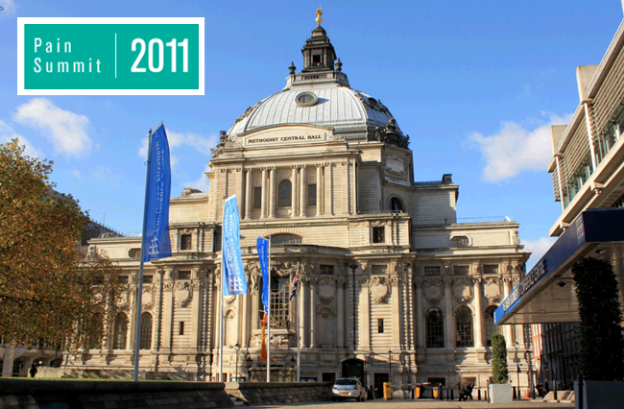
Pain Summit 2011
7 million people in the UK suffer from Chronic Pain
The average time for a patient to receive a satisfactory diagnosis is 2.2 years.

Slide 16
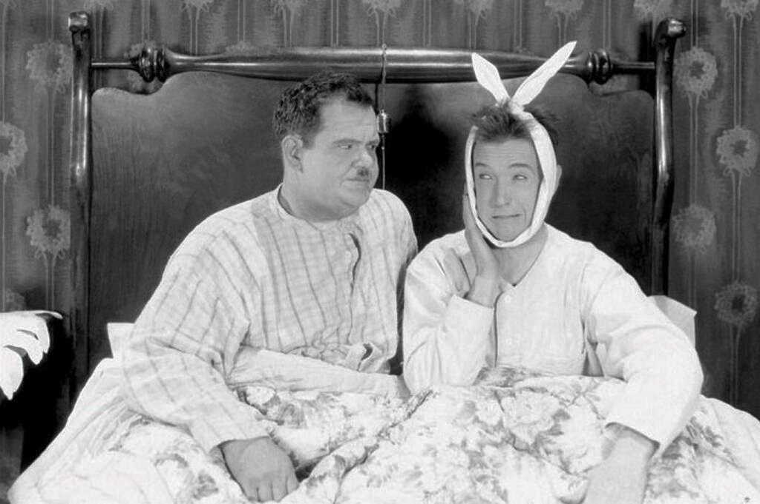

Slide 17
Authorities
Recently reported cases include Ellen Baker V Caroline Sumner (2010) Lawtel (Fibromyalgia, Total Damages £120,247)
Rahima Siddique V Bvba Rimotrans (2010) Lawtel (Fibromyalgia, Total Damages £350,000)
Chapman v Moulton [2011] Lawtel, (Fibromyalgia, Total Damages £595,000)
Jennifer Kolodziejcak V (1) Escolme (2) The Livesy Group [2007] Lawtel, (Fibromyalgia, Total Damages £137,500)
Also Edwards v Salford Primary Healthcare Trust (CRPS £1,000,000), Lawtel 2012.
Beard v Skanska (CPS £345,000) Lawtel 2012.

Slide 18
Identifying a Chronic Pain Condition

Slide 19
Role of the treating practitioner

Slide 20
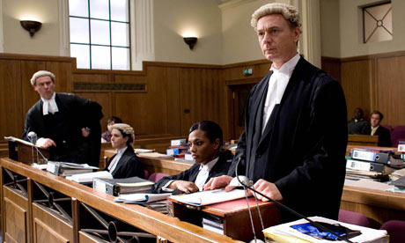
Arguments and Issues

Slide 21
Words of Warning

Slide 22
Fiona Ashworth
Kings Chambers
www.kingschambers.com
fashworth@kingschambers.com
www.chronicpainfionaashworth
Twitter ~ @ashworthpain
Tel: 0845 034 3444
Fax: 0845 034 3445

Slide 23
Thank you
Follow us on:
@kings_chambers kings-chambers

